Slide 1




Evidence-checking & chatbots - exploring new methods for disseminating Eurostat data
September 2022

Slide 2

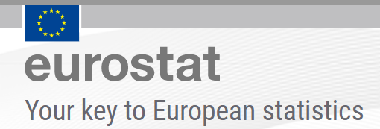
Introduction (1)
A series of experiments aiming at improving user experience of Eurostat data services
Using semantic analysis and natural language processing (NLP):
Semantic analysis: drawing meaning from textual resources
Natural language processing: methods bringing the interaction with the computer and the web closer to human language
Use of advanced methods from fields such as machine learning (ML) and artificial intelligence (AI)
This presentation:
Methodological challenges and decisions taken
Lessons learned, possible ways forward

Slide 3
Introduction (2)
Use cases – the scenarios tested:
A. ‘Asset querying’: Search for internal textual resources using common language and additional choices (categorisations) derived from the semantic linking of information
B. ‘Information retrieval’: As above, but searching for related resources in sites of external organisations for reasons of cross-checking Eurostat information; through the linking of Eurostat data assets with semantically related information in these sites
C. ‘Evidence-checking’: Identifying Eurostat statistical datasets relevant to 1-2 sentences found in the press or web, to cross-check the evidence read
D. ‘Databot’: Conducting a dialogue in common language with a specialised bot (databot), for the identification of texts or datasets of interest
Research-grade prototype tools implemented as Python notebooks and visualisation applications with R Shiny and MS Power BI
A dedicated GitHub repository

Slide 4
Information Repository
The experiments were supported by a special Information Repository (a Virtuoso system):
Content Database: usual tabular data
Knowledge Database: a parallel special structure with edges connecting pairs of nodes / entities(*) with various types of relationships → hence the alternative name ‘Knowledge Graph’
Indicative content:
Statistics Explained (SE) articles
SE Glossary articles
Eurostat Concepts and Definitions Database (CODED) in RAMON
The hierarchy of nodes in Eurostat database tree
OECD Glossary of Statistical Terms
In both the content and the knowledge database: various relationships derived through NLP and semantic analysis
entity A
label
directed relationship: A (predicate) B
entity B
(*) The entities can be anything: texts, datasets, external sources, concepts, etc.

Slide 5
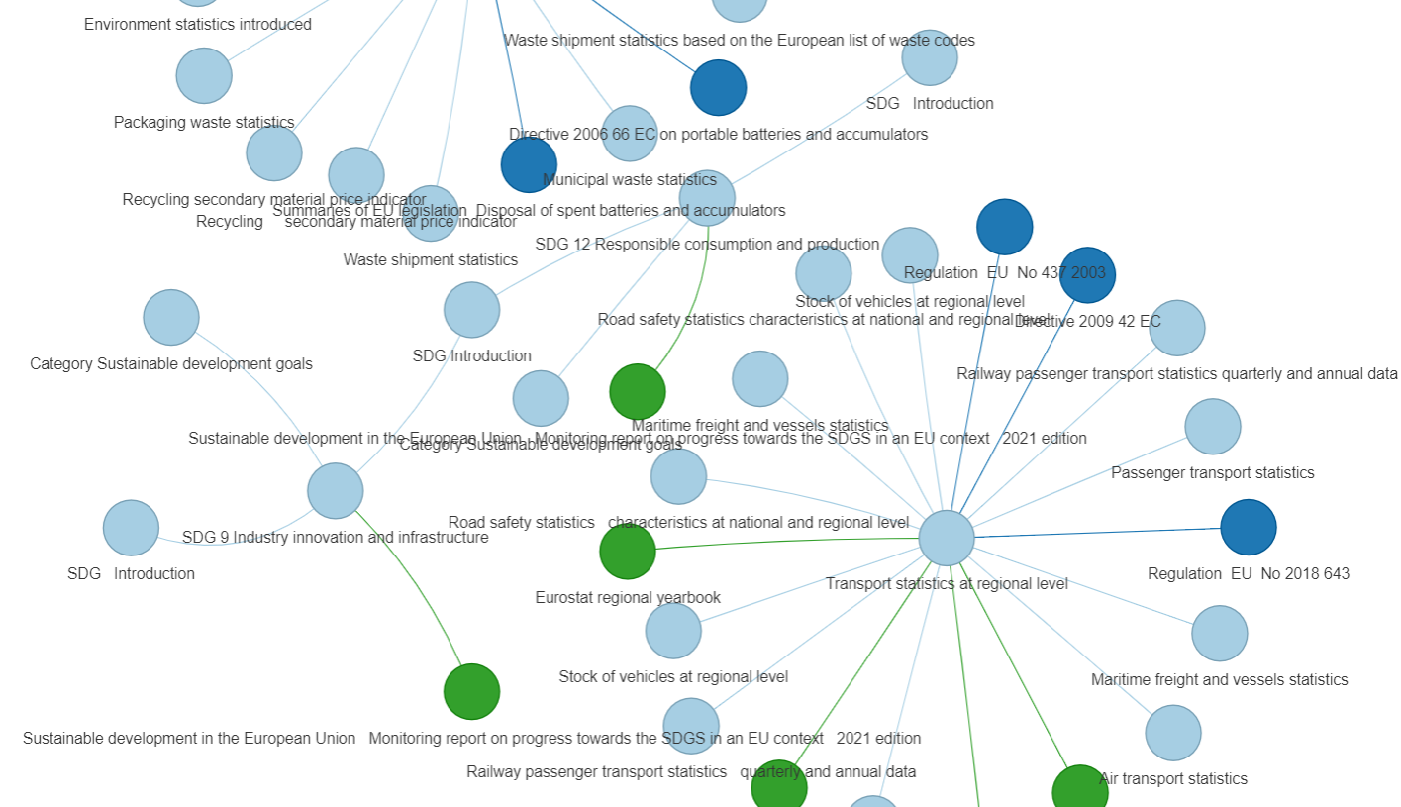
Knowledge Database (1)
Knowledge graph visualisation
Example of some relationships extracted from the Knowledge Database with keywords ‘electric vehicle’ (partial output)
The central nodes are SE articles and are connected to related general data assets
The colours indicate the different types of the related data assets: other SE articles, SE Glossary articles, Publications, Legislation, etc.

Slide 6
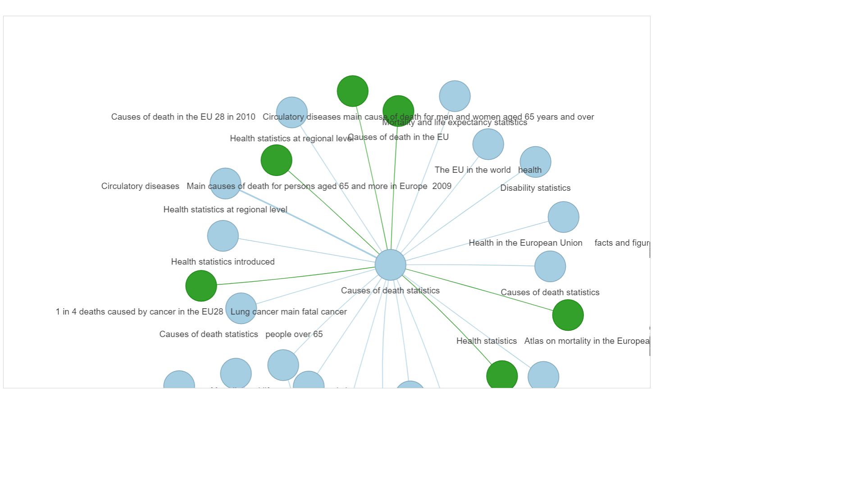
Knowledge Database (2)
Keywords: ‘morbidity statistics’ (partial output)
Google Colab notebook available here

Slide 7
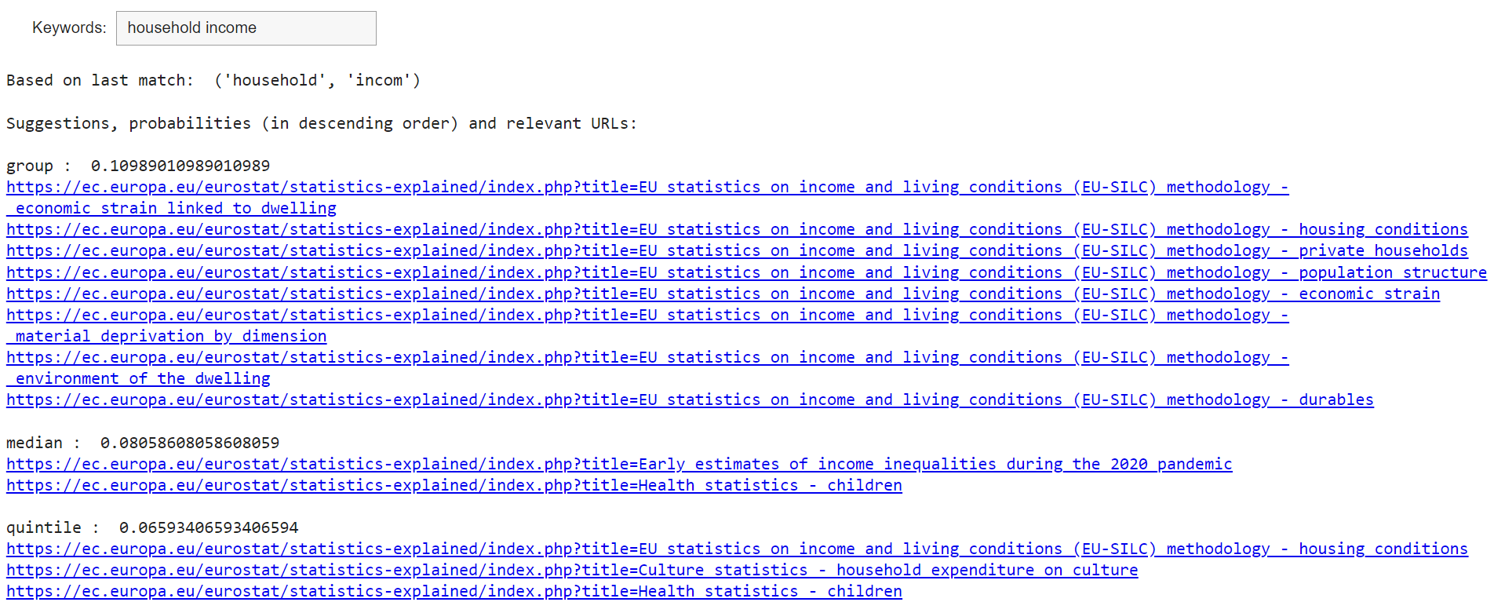
Use case A (1): ‘Asset querying’ – Making the most of internal data assets
Objective: exploit relations between unstructured textual data assets, concepts and classifications, in order to provide the user who is searching for information in Eurostat website with an improved experience
Using the stems of words in the search
First mode: Query Builder:
Search for SE articles
Help the user build a query by suggesting promising keywords (with associated scores)
Better than some existing search tools but does not take into account terms semantically related to the keywords entered – a weakness
A Google Colab notebook available here
Many more suggestions not shown

Slide 8
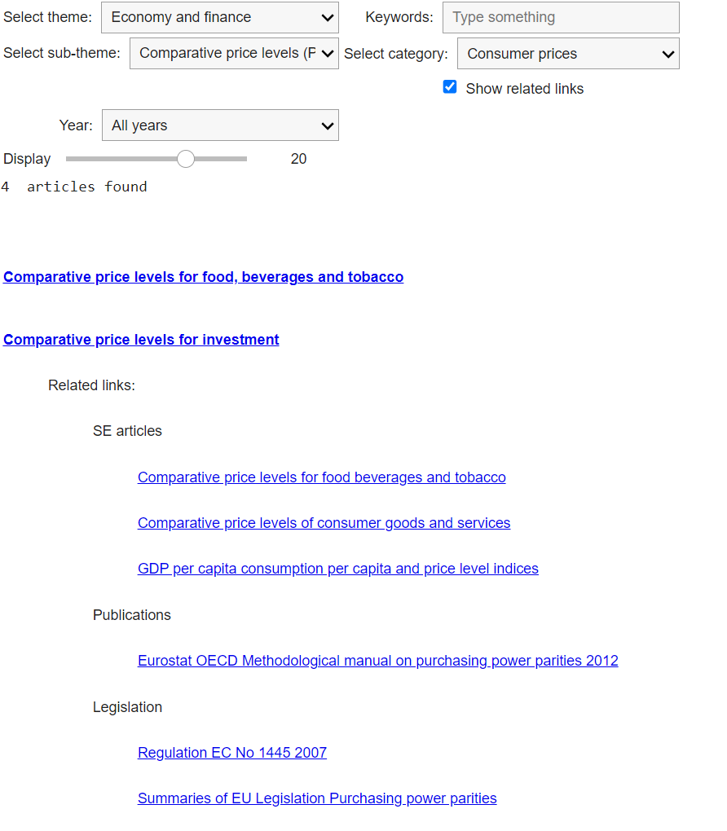
Use case A (2)
Second mode: Faceted Search:
Again search for SE articles
Specific objective: search along conceptual dimensions / slices of the results → additional non-obvious filtering options
We use Eurostat themes and sub-themes, linked with the category tags, using a mapping of categories to (possibly multiple) Eurostat themes and sub-themes
The tool also displays links to general data assets related to the main results - SE articles: (other SE articles, SE Glossary articles, Publications, Legislation, etc.)
A Google Colab notebook available here
Two of the four articles shown
Other related resources (in category ‘Other’)

Slide 9
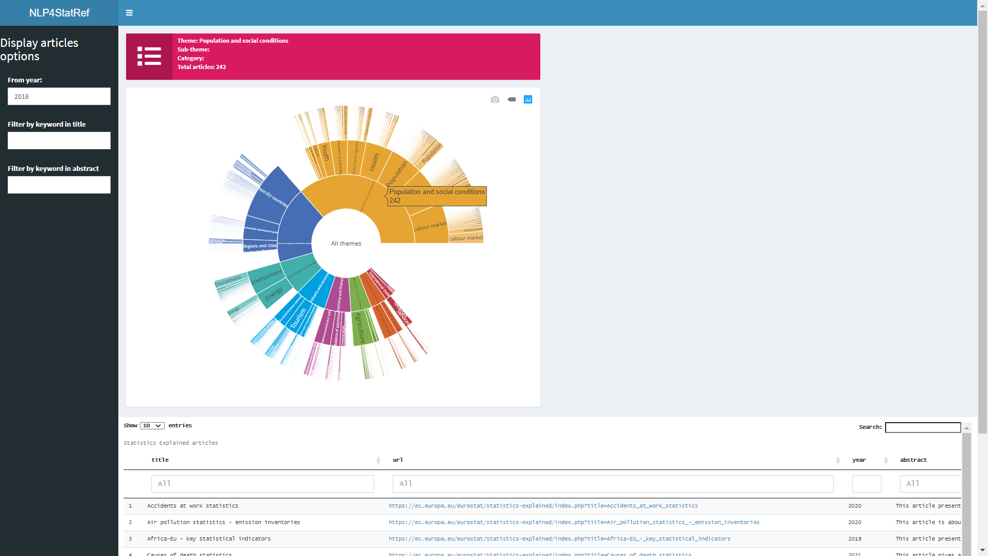
Use case A (3)
Graphical exploration-1: An R Shiny application
Main features:
A dynamic sunburst plot which allows navigation based on themes, sub-themes and available categories below the sub-themes
Current selection shown at the centre of the plot – can change selection (drill-down) by clicking on any segment
At each step, clicking at the centre of the plot allows back-stepping to the previous (more general) selection
Filters and drill-down by keyword functionality in the results
A temporary link to an online version here

Slide 10
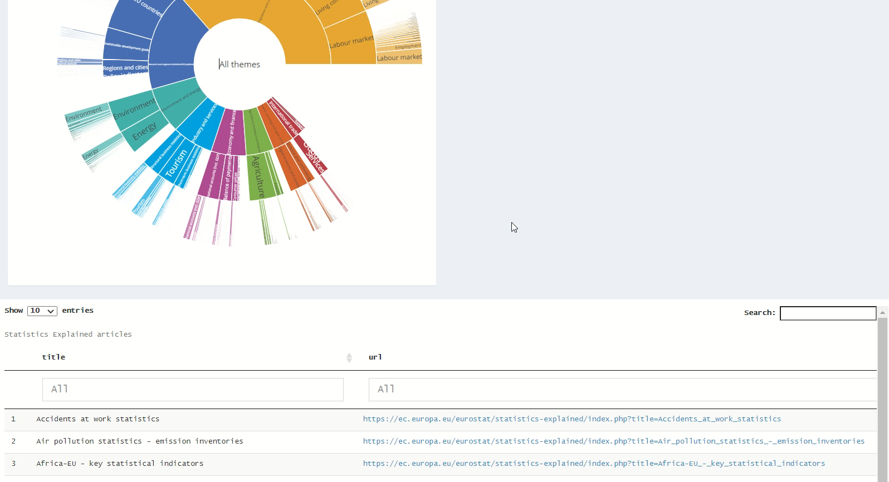

Use case A (3)
A small video
Click to play

Slide 11
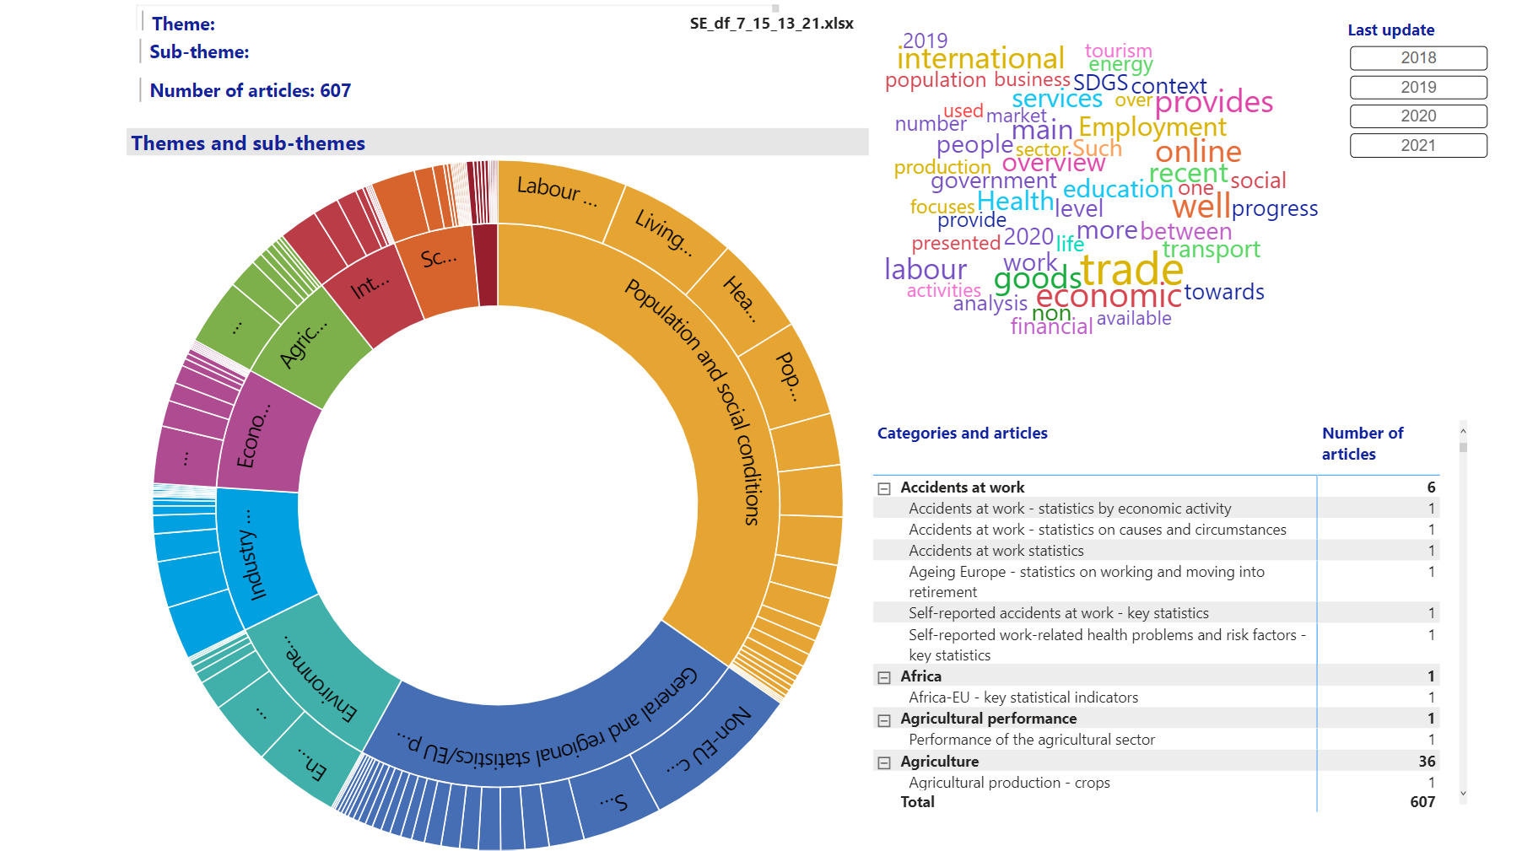
Use case A (4)
Graphical exploration-2: An MS Power BI application
Again exploring SE articles
Many more capabilities
A temporary link to an online version here

Slide 12
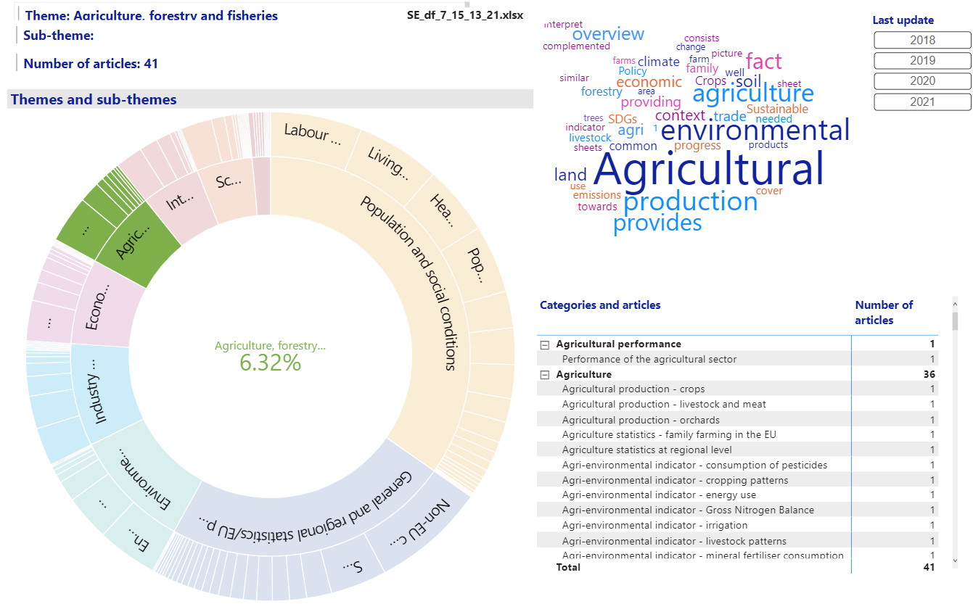
Use case A (5)

Slide 13
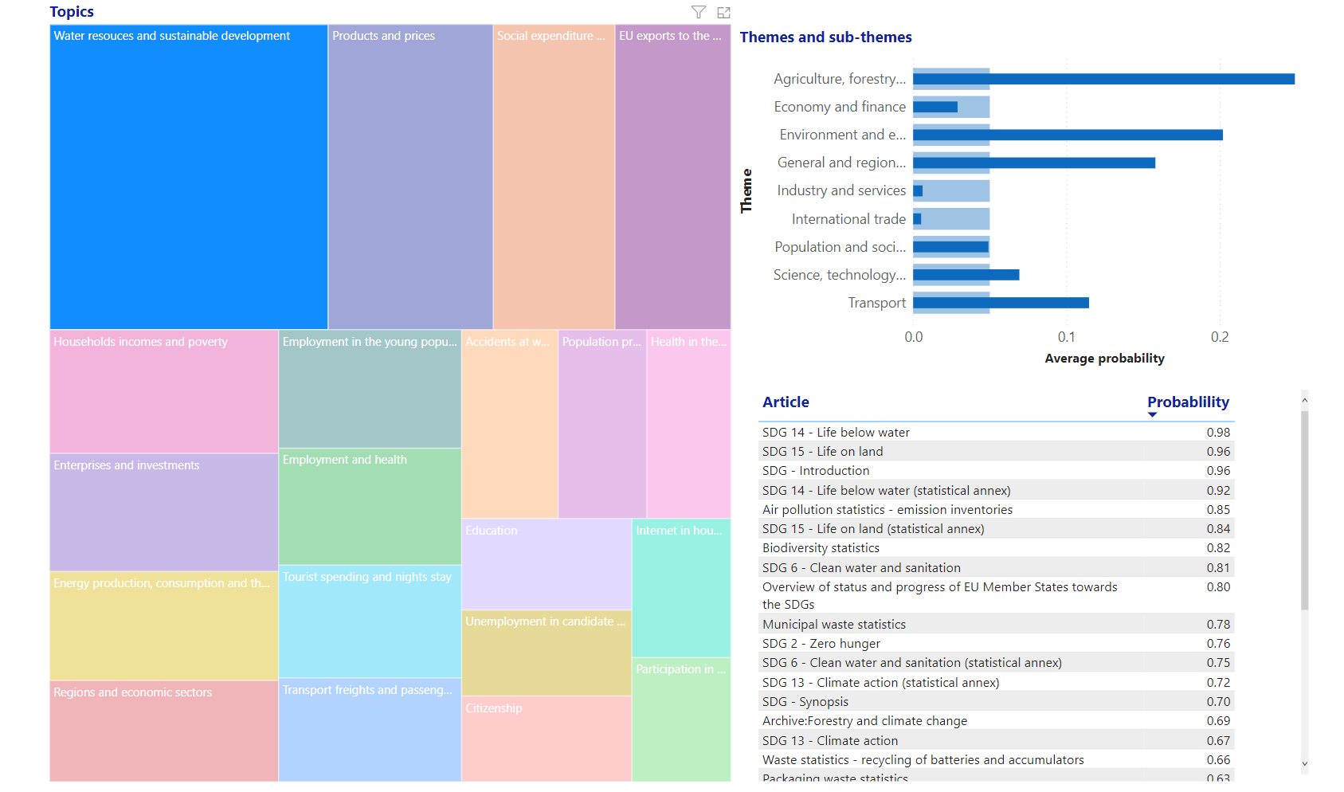
Use case A (6)
Closeness of the selected topic with the themes and sub-themes
Also uses the results of topic modelling:
Extract ‘topics’ – thematic areas from a corpus (here, SE articles) so that each text is a weighted sum of the topics and each topic is a weighted sum of the words
The topics are subject to human interpretation
Derived relationships (not in existing content): example of enrichment
Topic selected: ‘Water resources and sustainable development’

Slide 14
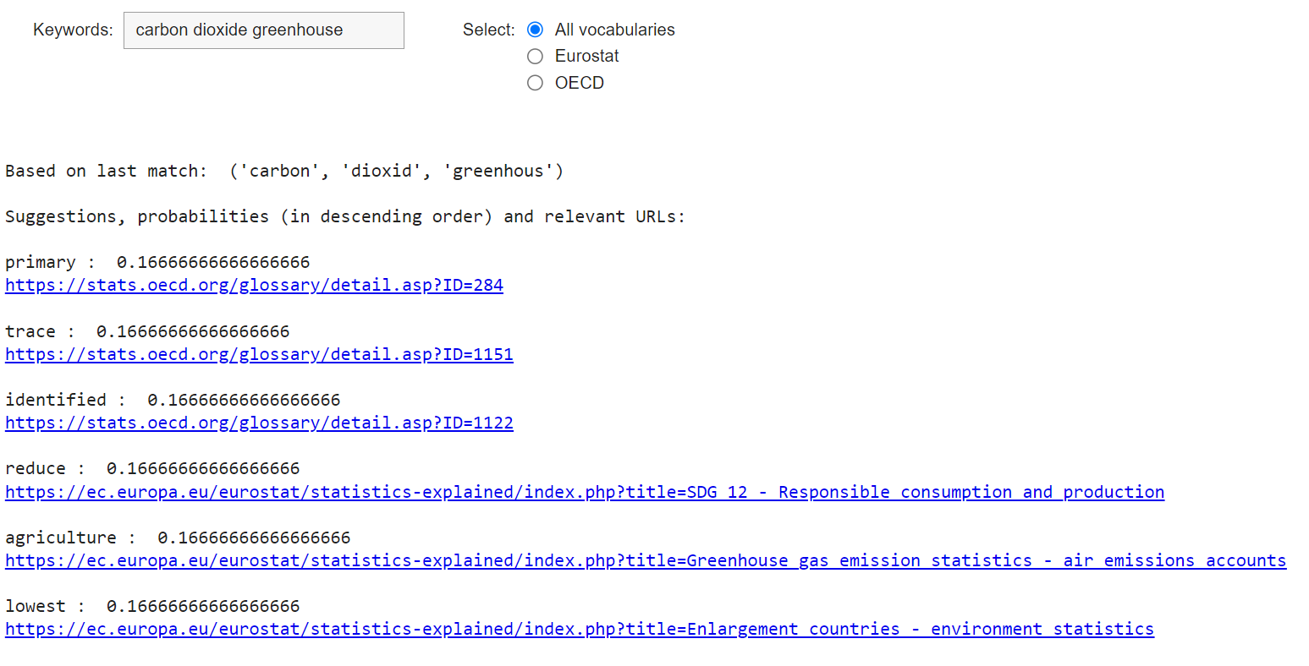
Use case B (1): ‘Information retrieval’ – Linking official statistics assets to external sources of information
Objective: link Eurostat data assets to external data sources in order to query or explore unstructured data from external organisations - we focused on the OECD Glossary of Statistical Terms
First mode: Query Builder:
As in use case A
The default is to search in both SE articles and OECD Glossary entries
Same weakness as in use case A – more like a ‘Query Extender’
A Google Colab notebook available here

Slide 15
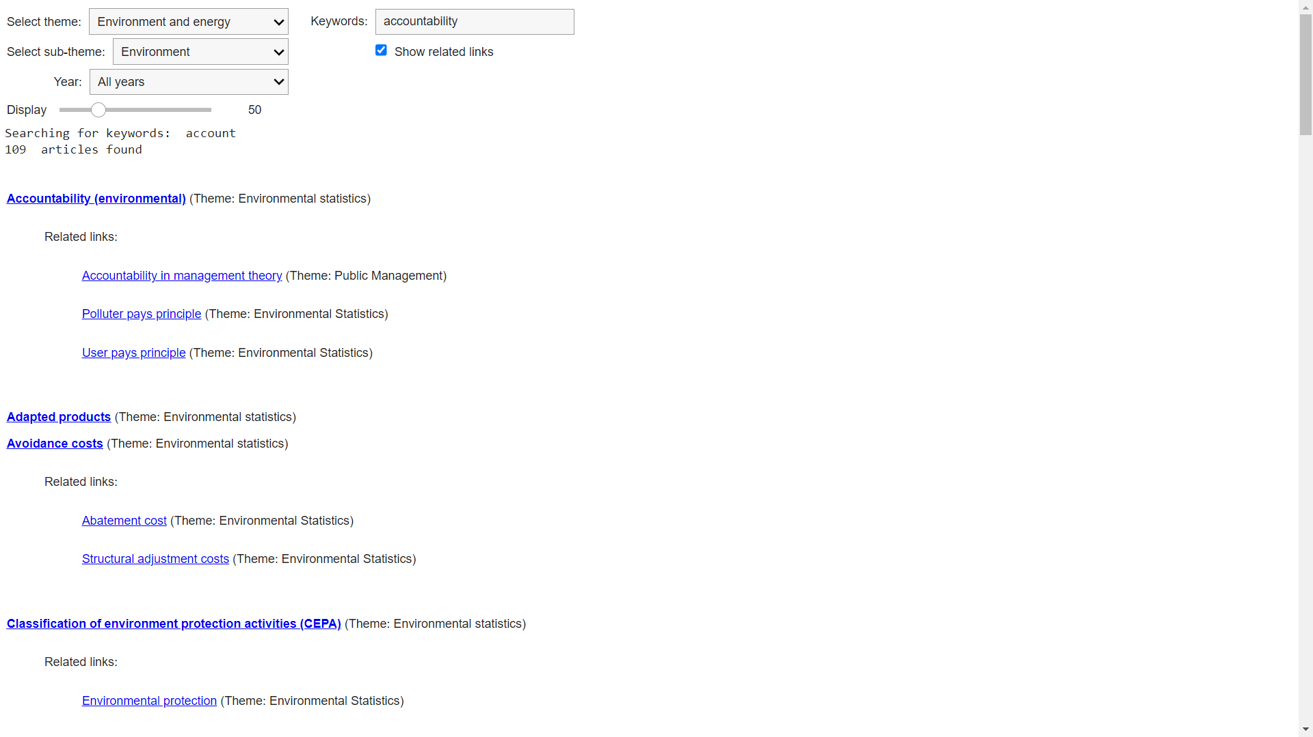
Use case B (2)
Second mode: Faceted Search:
Search for OECD articles, but using Eurostat themes and sub-themes
Though a manually constructed mapping of Eurostat themes / sub-themes to OECD themes
Also display OECD themes in both the main results and in the links to entries related to (referenced by) the main results
Could have added articles referring to the main results (not implemented)
A Google Colab notebook available here

Slide 16
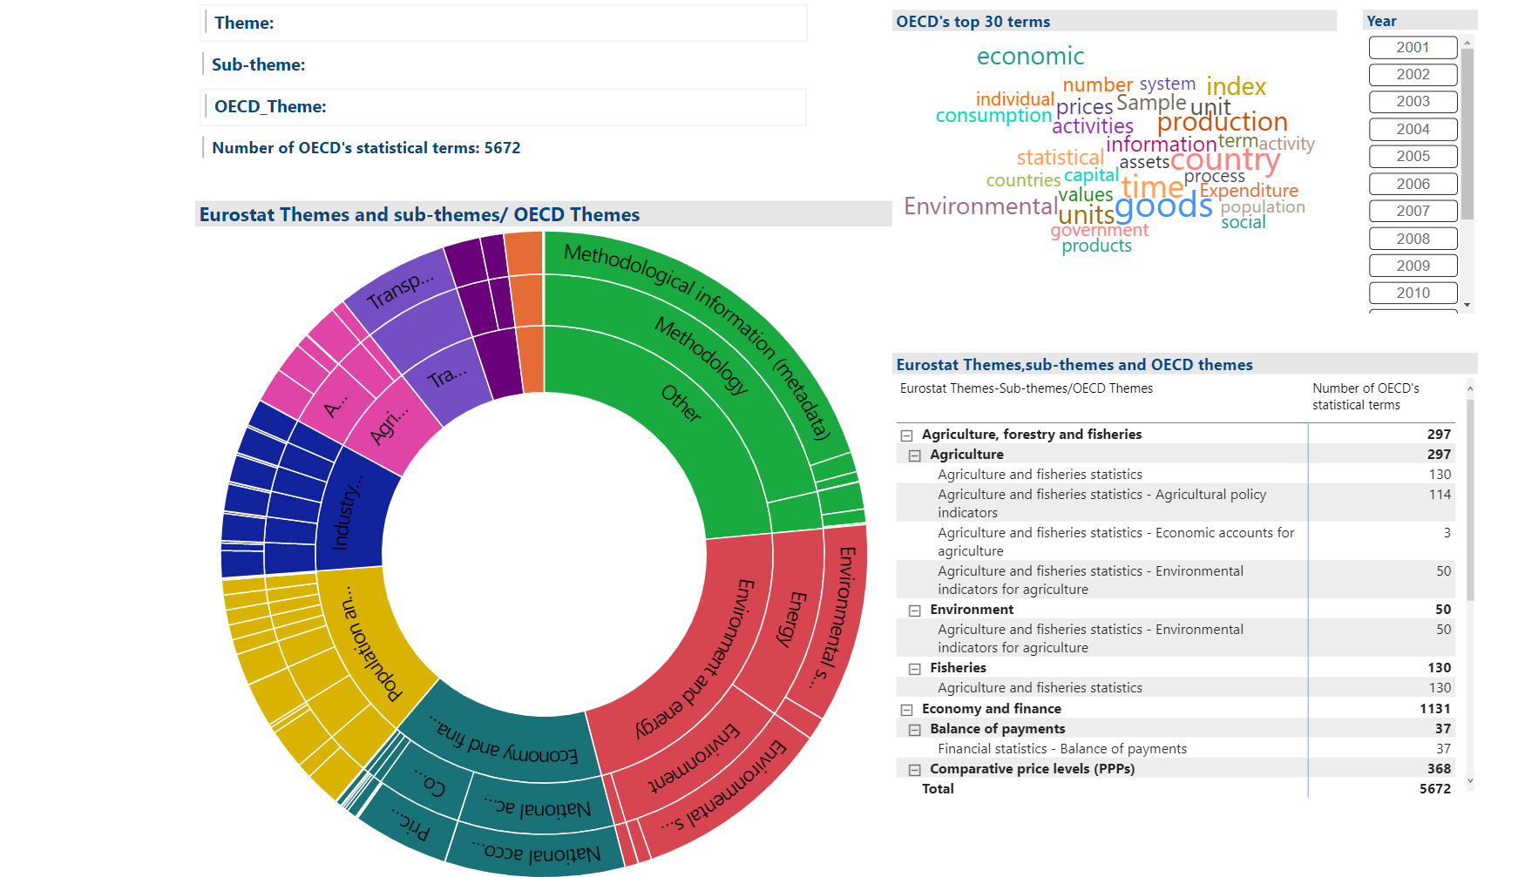
Use case B (3)
Graphical exploration: An MS Power BI application
The results displayed now are OECD articles
The level below Eurostat themes and sub-themes has the available OECD themes
Just for demonstration of using an external classification; could equally well have used Eurostat categories in the last level
A temporary link to an online version here

Slide 17
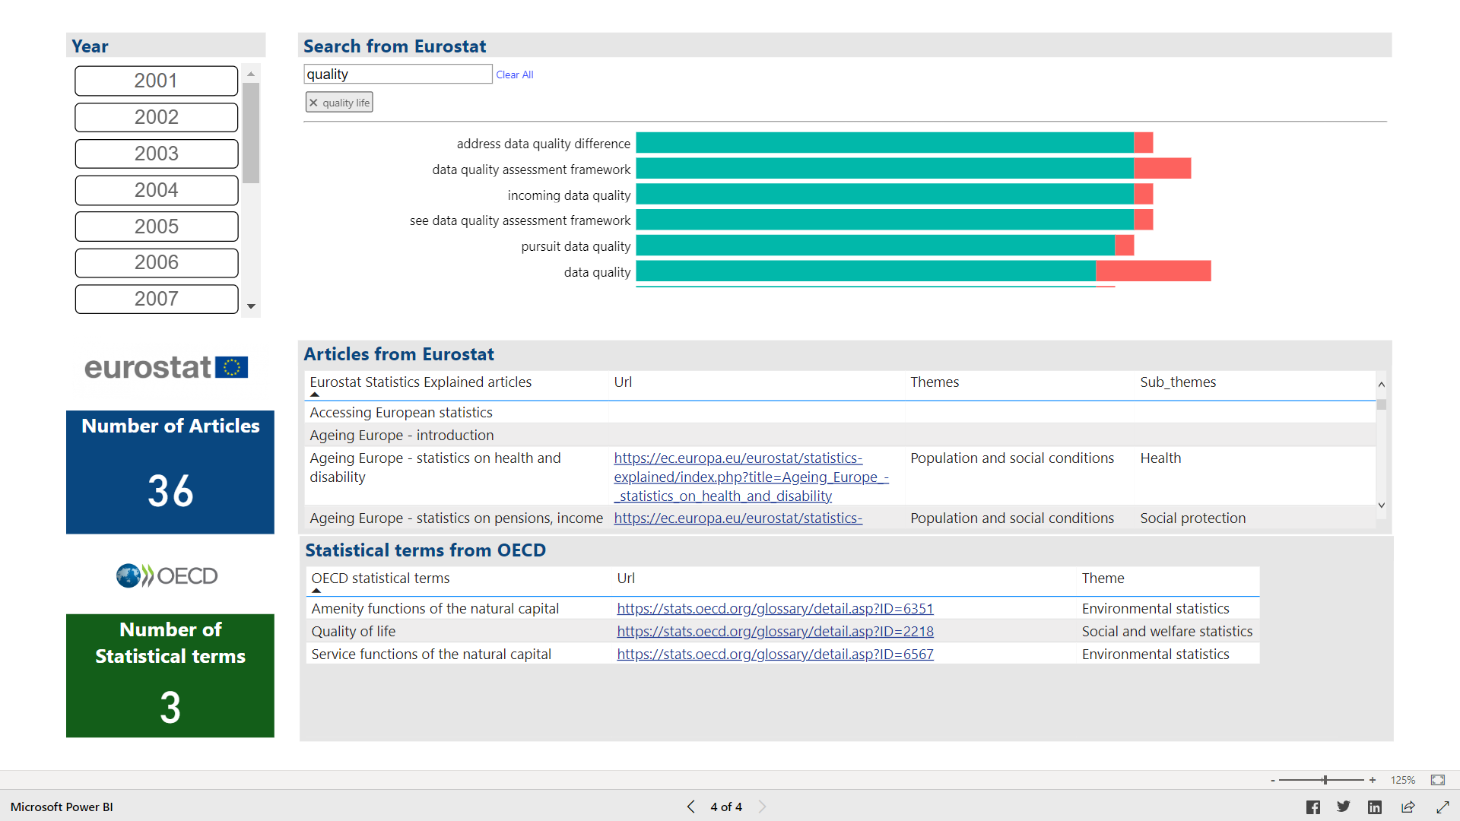
Use case B (4)
Uses, among others, the results of another enrichment method:
Common noun phrases(*) in SE articles and OECD ones: suggestions – tags which can be added to the query
Can be considered as an alternative Query Builder
(*) A noun phrase is a groups of words that functions like a noun

Slide 18
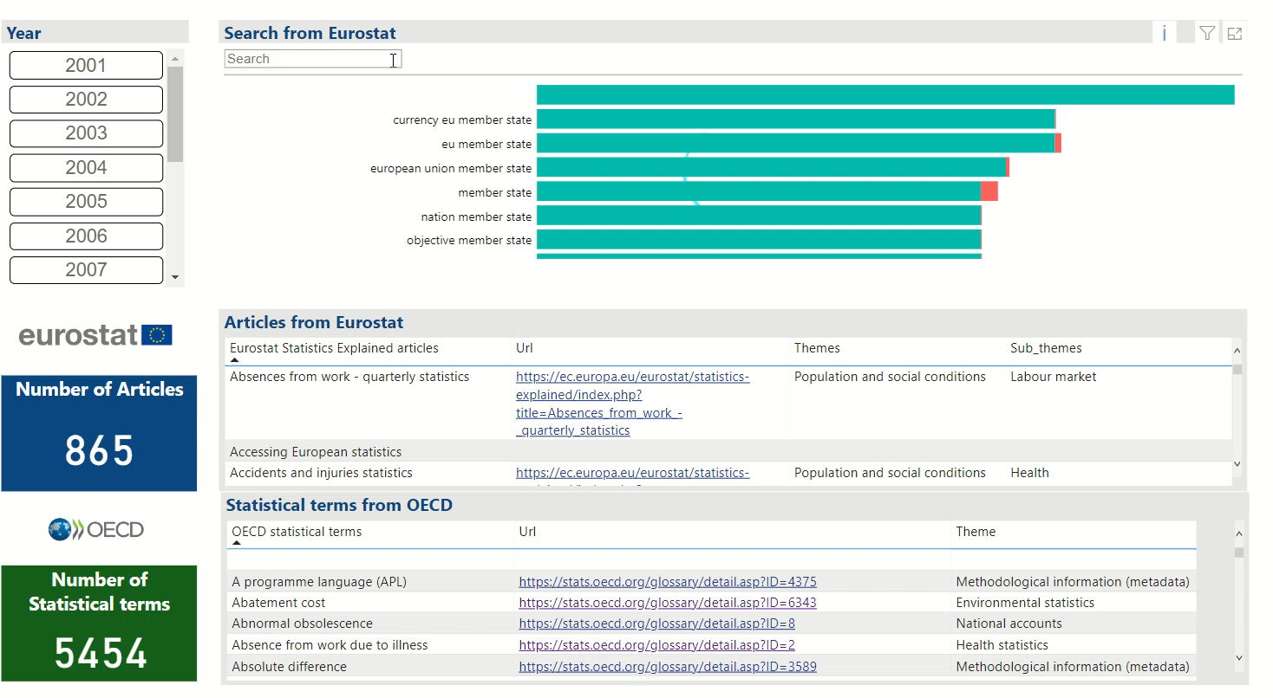
A small video
Click to play

Slide 19
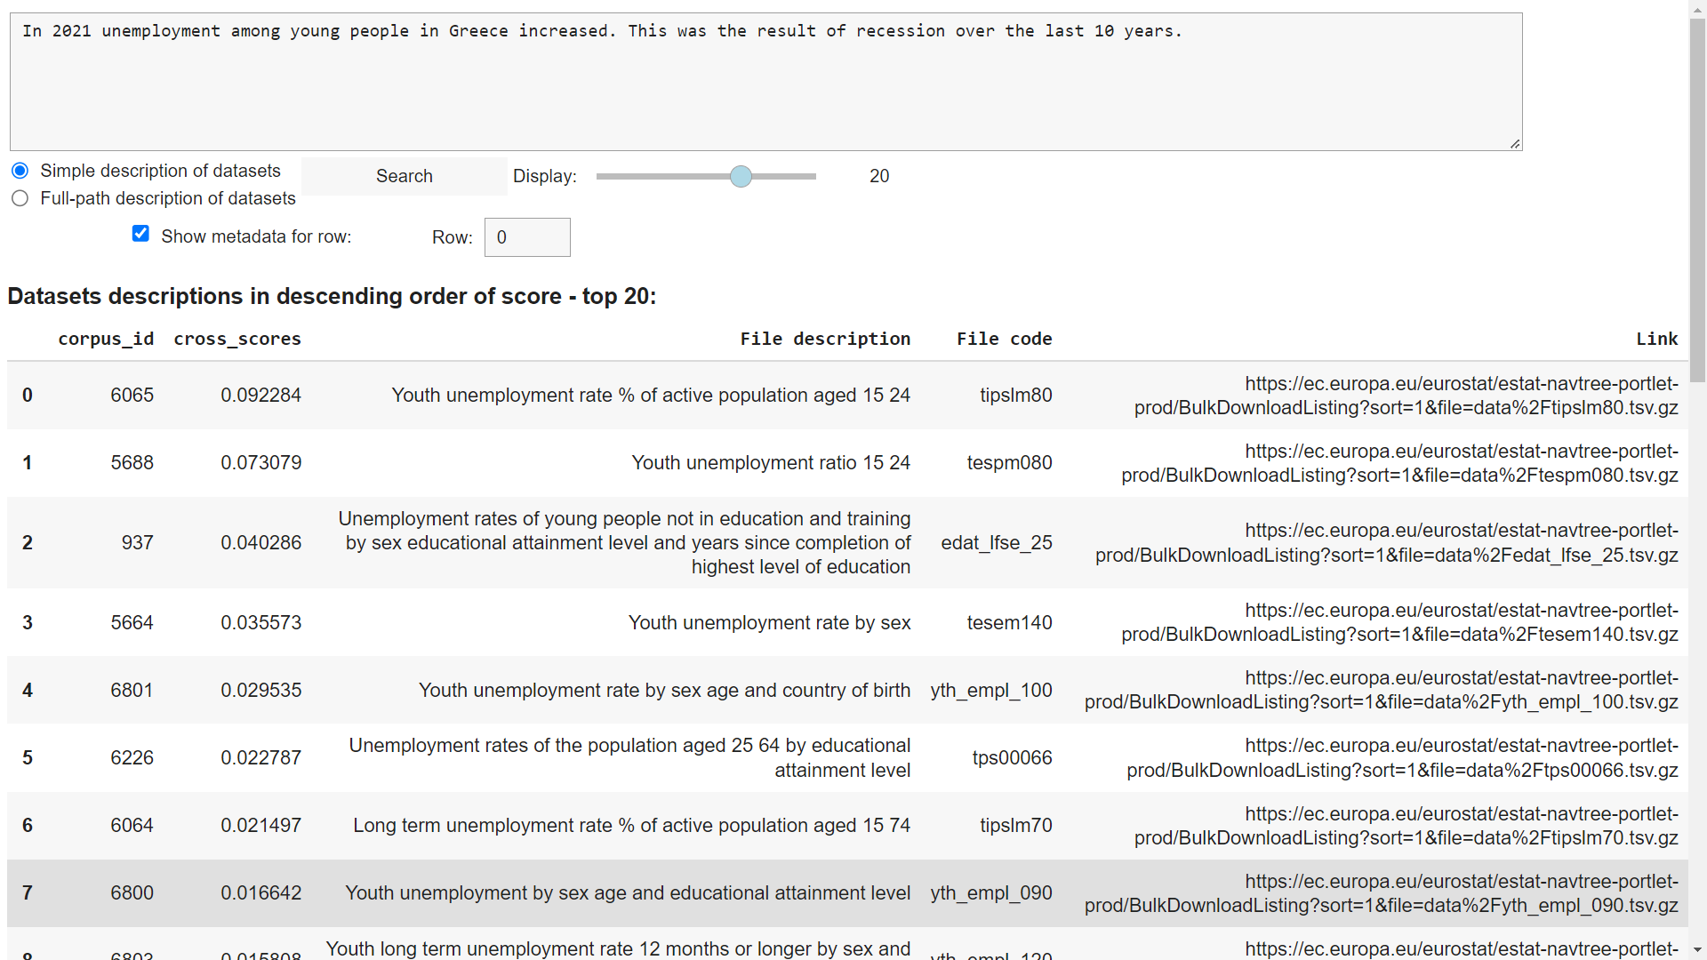
Use case C (1): ‘Evidence checking’ – Identifying data assets from textual content
Objective: cross-check the facts mentioned in a piece from the press or web by exploring the most relevant statistical datasets in Eurostat database
First approach: Using word embeddings:
An NLP method which allows to find the similarity between words and sentences
Creates a dictionary with each word having associated numbers
Usually available ‘pre-trained’ from the analysis of some general corpus
Instead here we constructed them exclusively from Eurostat content (SE articles and SE Glossary articles)
Code available here

Slide 20
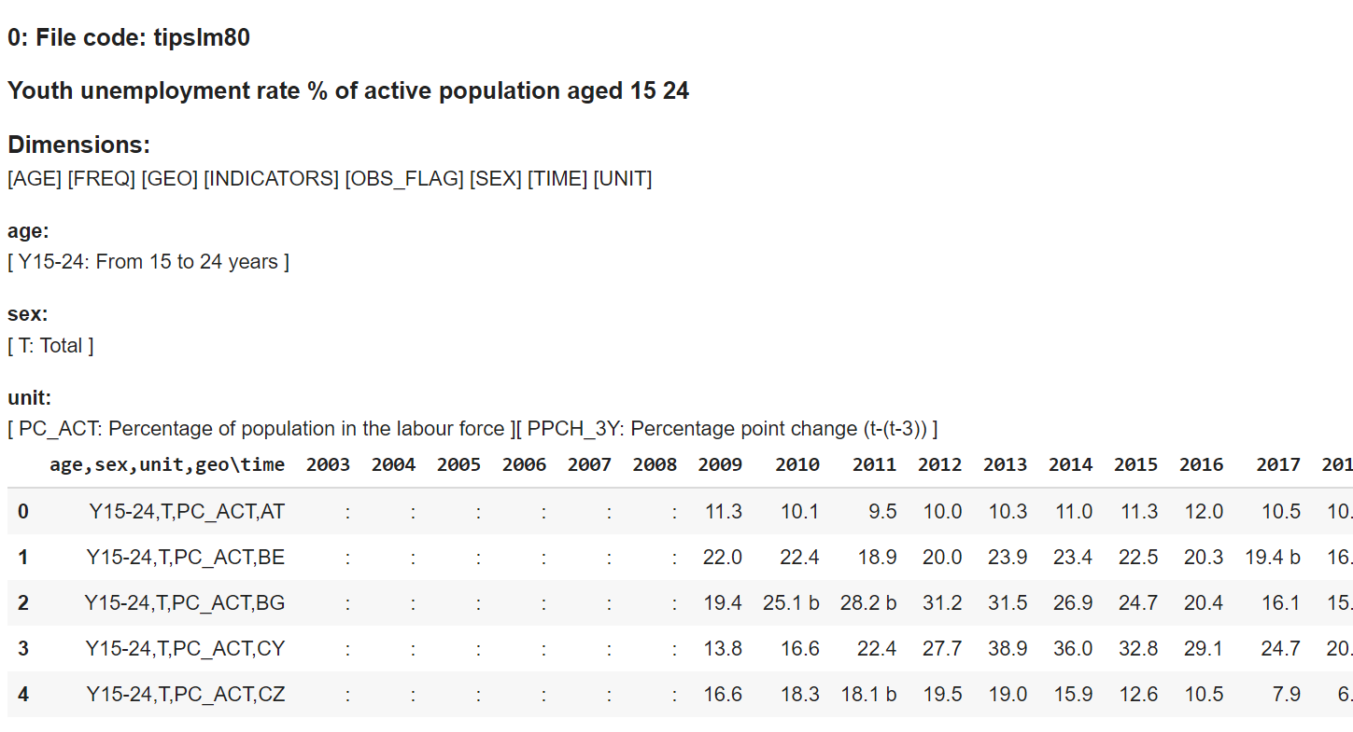
Use case C (2)
Also display the metadata and sample data for a selected dataset in the results

Slide 21
Use case C (3)
For the semantic similarity matches we used the descriptions of the datasets in Eurostat database tree, either as the titles at the ‘leaves’ of the tree, or as the ‘full paths’ (excluding the top-level branches)
Some difficulties because the descriptions of the datasets were short
Could not use the summaries which appear in a fraction of the datasets (almost repeated for several datasets)
Using, in addition, the metadata (e.g. dimensions in the datasets) could improve the results but this was not tested

Slide 22
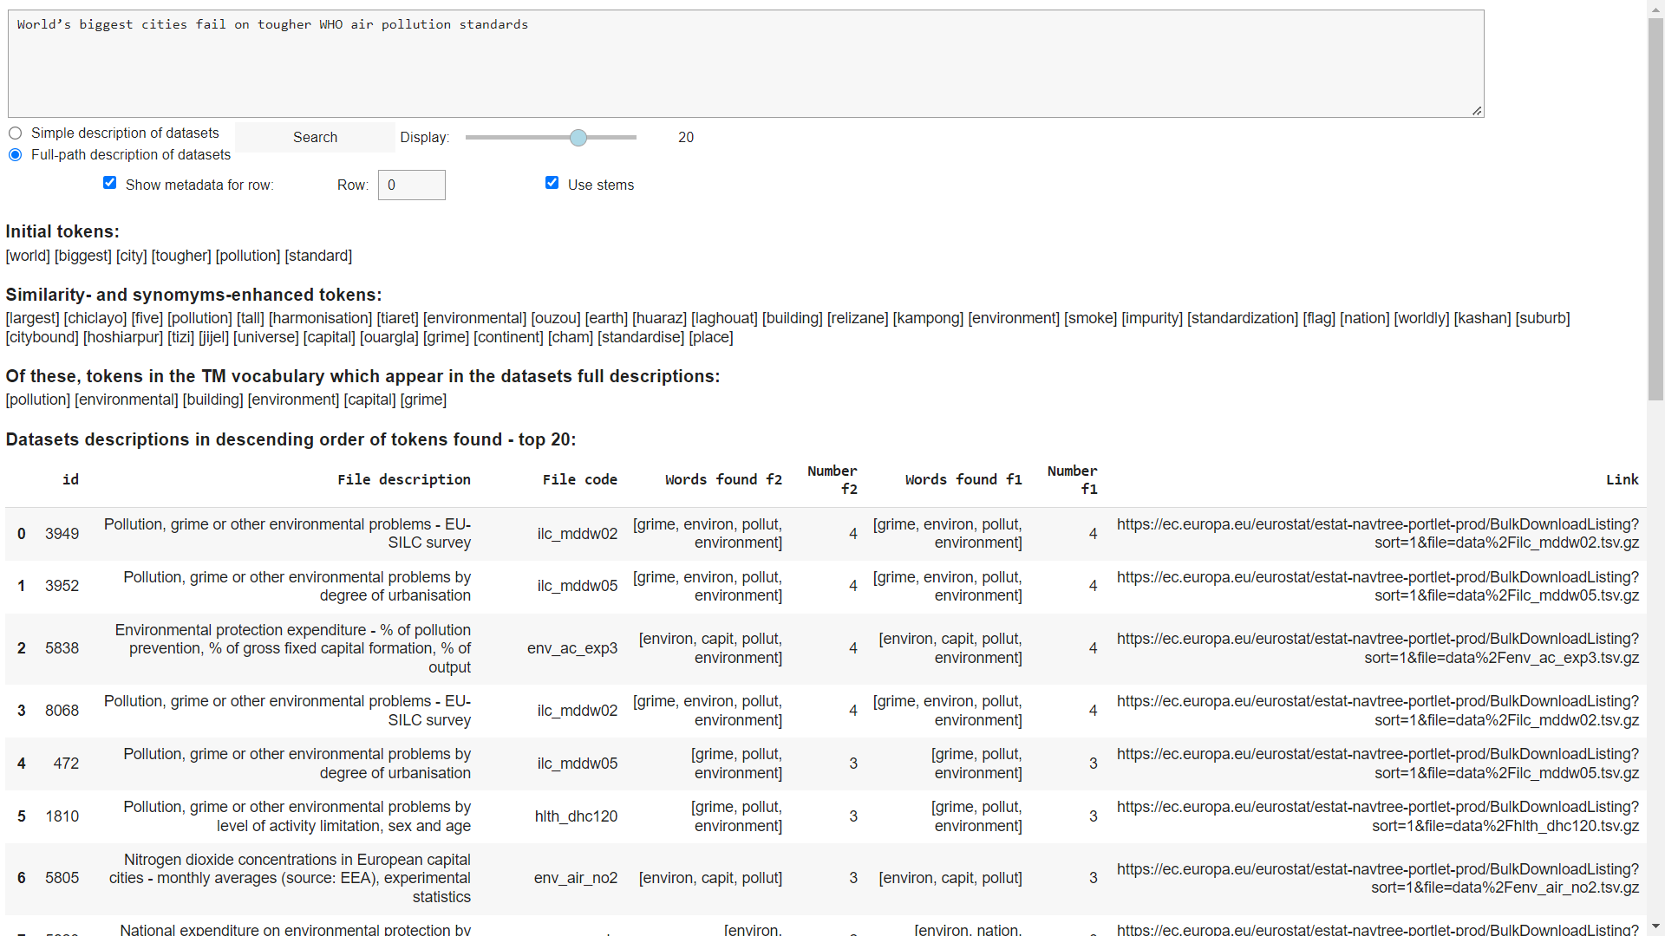
Use case C (4)
Numerous terms from the enrichment
of the query – some of them irrelevant(*)
Second approach: Using topic modelling and word embeddings:
Enhancement of the previous code with the topic modelling enrichment method
Also enrichment of the user query with related terms and synonyms from ConceptNet (an external knowledge graph)
Code available here
(*) Reasoning: more chances for matches with the additional terms which appear in the descriptions of the datasets
Highly irrelevant terms not found in the descriptions are simply discarded. But:
Disadvantage: Irrelevant terms which do appear in the descriptions!

Slide 23
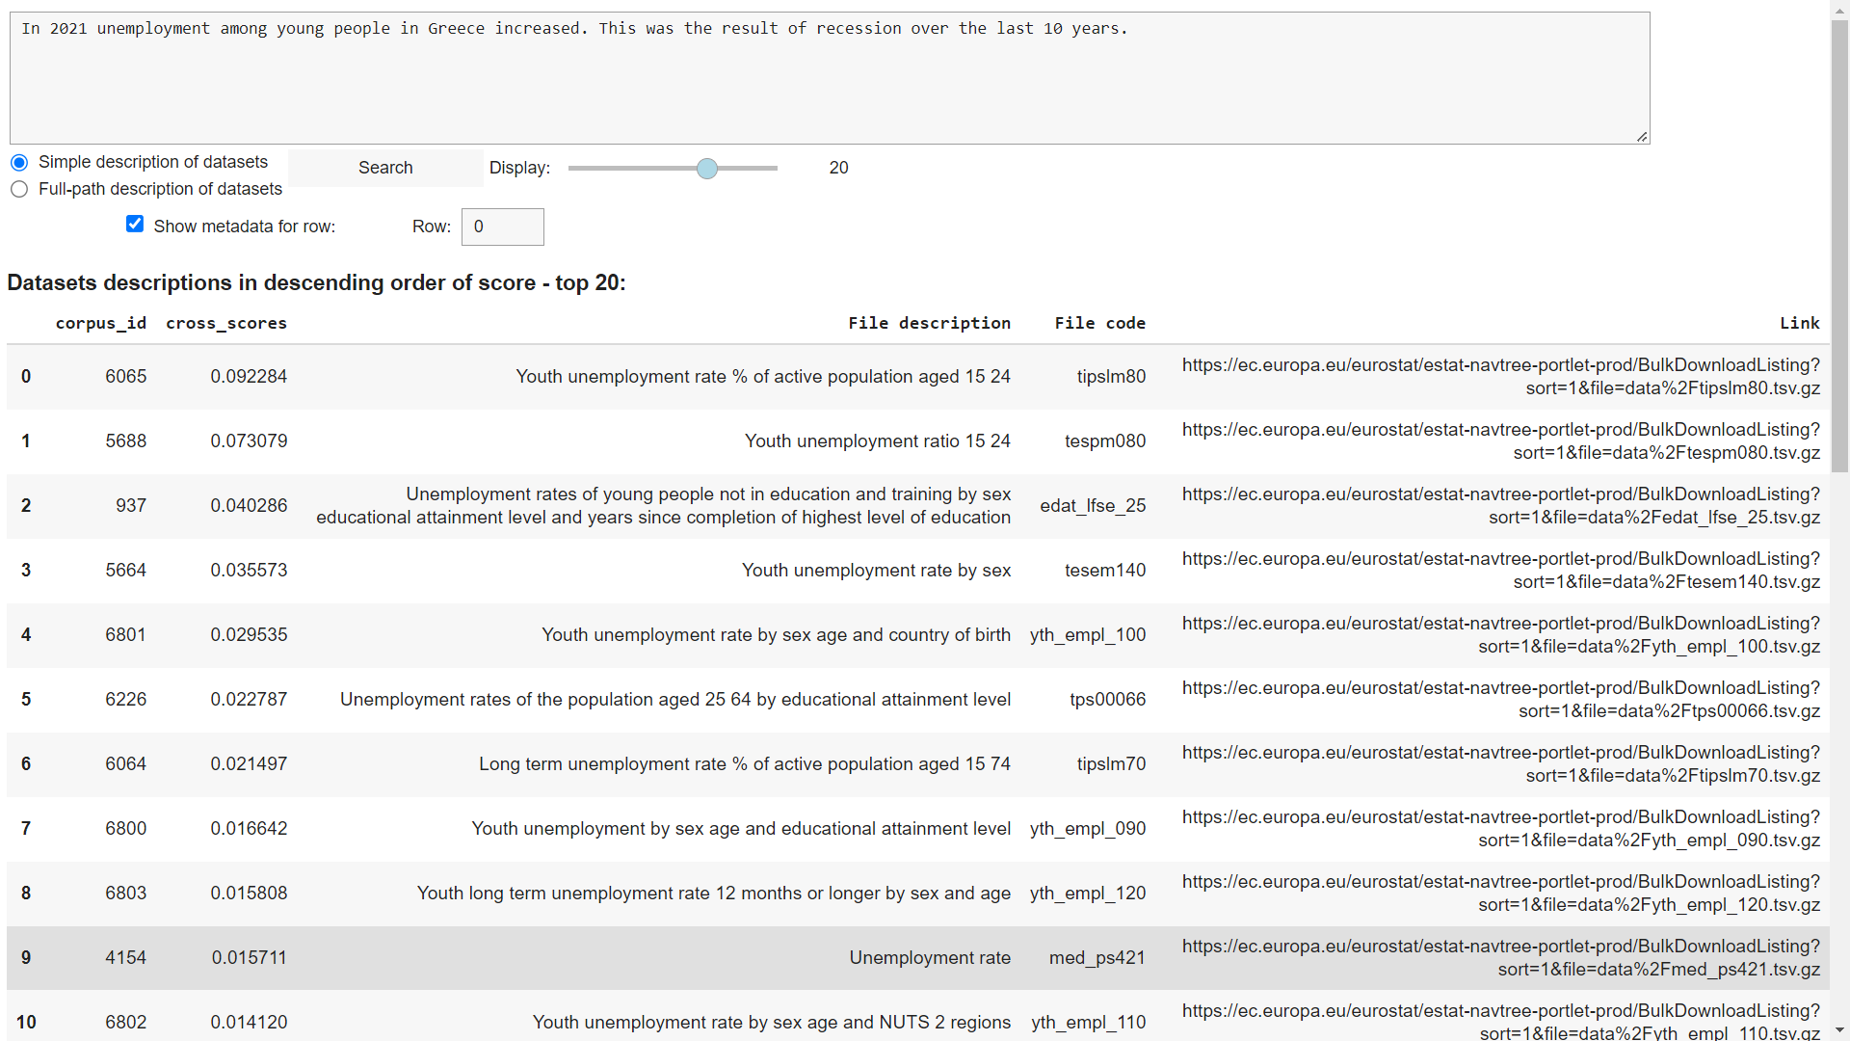
Use case C (5)
Third approach: a variant of the (widely popular) BERT(*) algorithm
Introduced and open-sourced by Google in 2018(**)
A neural network-based technique for NLP which has many advantages in understanding a context and in detecting similarities between texts
Code available here
(*) Bidirectional Encoder Representations from Transformers
(**) Devlin et al., 2018. BERT: Pre-training of Deep Bidirectional Transformers for Language Understanding.arXiv preprint arXiv:1810.04805

Slide 24
Use case D (1): ‘Databot’ – Matching natural language with data needs
Objective: Implement a databot exploiting semantic AI / ML technologies
Rapidly growing field of conversational AI, which:
Iteratively applies Natural Language Understanding (NLU) techniques to extract meaning from the interaction with the user
Applies similar methods as in the previous use cases to ask clarification questions at each iteration and narrow-down the candidate proposals to the user
Delivers the final proposals for the relevant datasets or texts (articles)
In the implementation we used the DeepPavlov framework and the variant of the BERT algorithm from use case C
Code available here

Slide 25
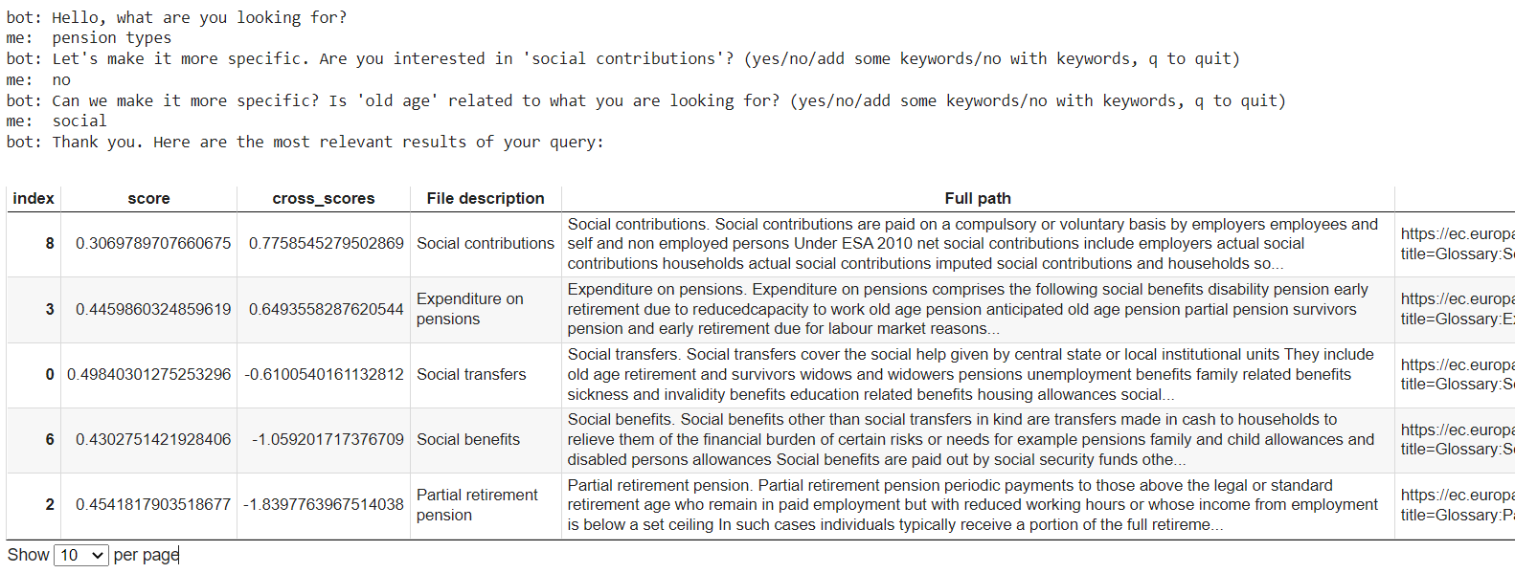
Use case D (2)
Searching for the types of pensions in SE Glossary articles

Slide 26
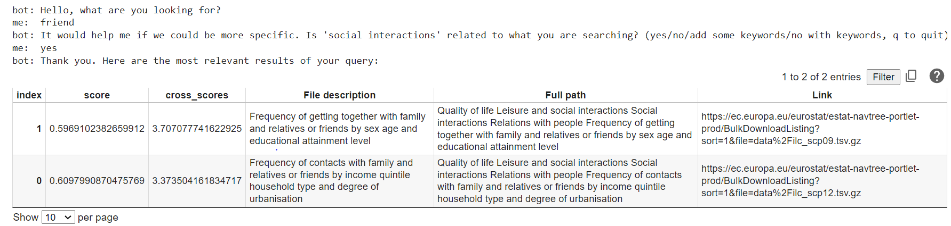
Use case D (3)
Searching for social interactions in datasets

Slide 27
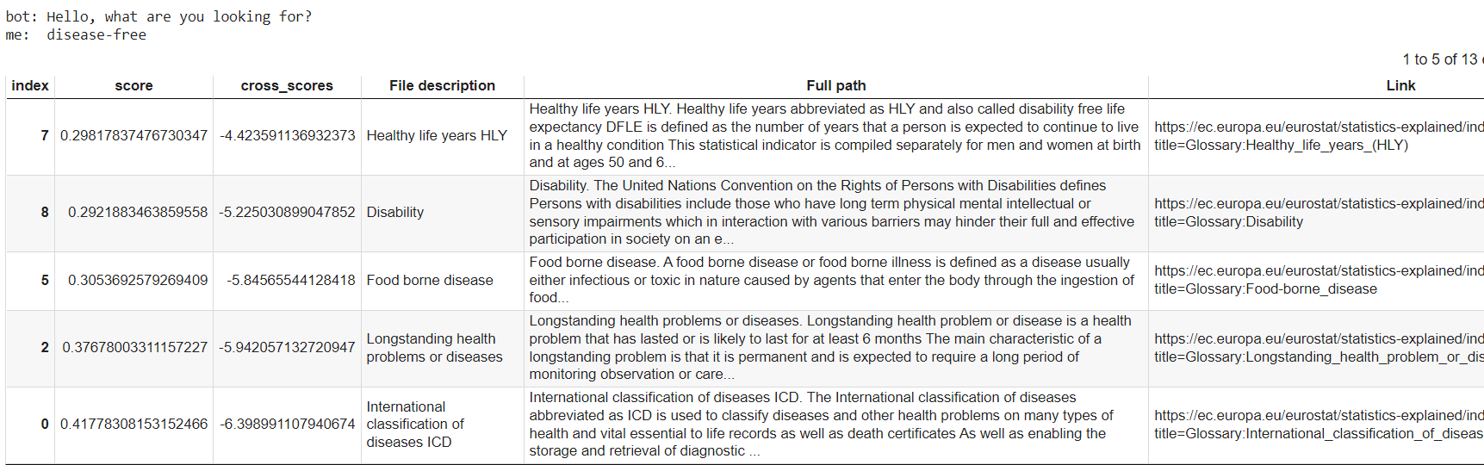
Use case D (4)
Searching for healthy life years in SE Glossary articles

Slide 28
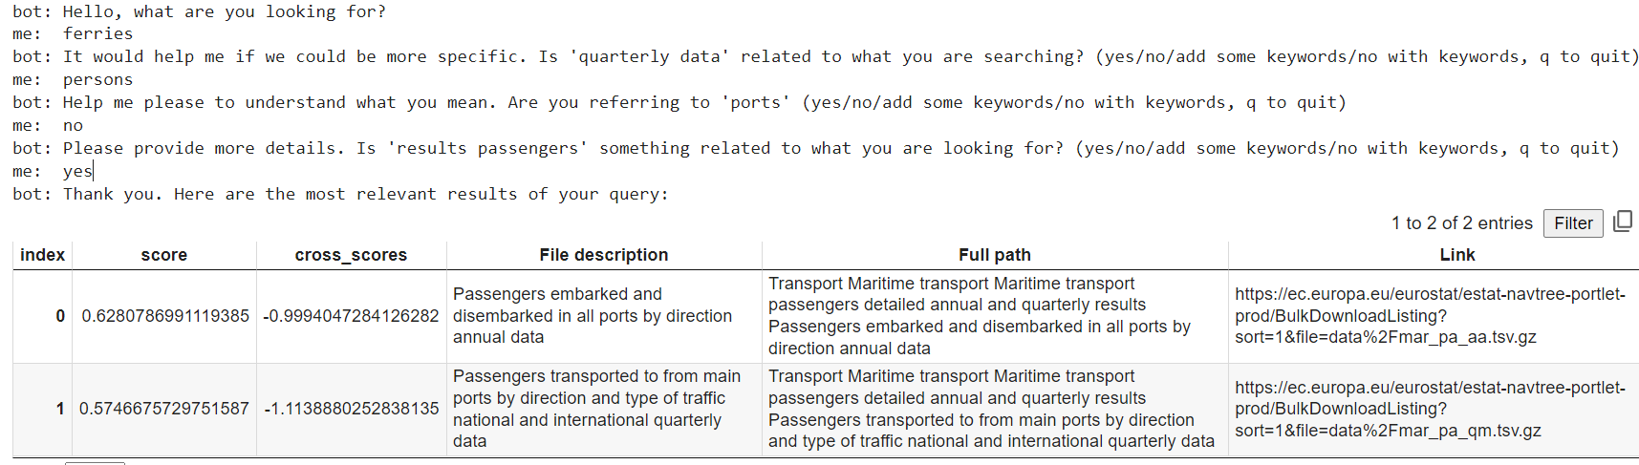
Use case D (5)
Searching for passengers in maritime transport in datasets

Slide 29
Conclusions - lessons learned and recommendations for future work (1)
Information repository construction
The entities in Eurostat’s content (articles, datasets, other data assets, concepts, classifications, etc.) are more than sufficiently interconnected
Many relationships between these entities and also a large variety in these relationships; Furthermore, many of these relationships point to external sources
All these resources and relationships allowed the building of a very rich ontology(*) with numerous classes and many object and data properties
Many future opportunities with the forthcoming migration of RAMON to the EU Vocabularies as Linked Open Data (LOD)
RAMON contains much valuable information for the semantic annotation of Eurostat and external organisations content
(*) The model in a knowledge database. It is designed in an Object Oriented Programming (OOP) way, with classes and object and data properties

Slide 30
Conclusions - lessons learned and recommendations for future work (2)
The availability of the information in RAMON as LOD will bring a tremendous opportunity to adjust the current Knowledge Database model and have the KD populated directly from the EU Vocabularies, bringing-in many more useful relationships, easily updated with an automated process
Use case A – ‘Asset querying’
Weakness in the Query Builder which operates rather like a ‘query extender’:
Use of ontologies from EU Vocabularies, such as Digital Europa Thesaurus, which was not used due to the lack of a controlled vocabulary created from official statistics content
Focus more in the approach with noun phrases demonstrated in the MS Power BI application in use case B (‘Information retrieval’) which did not exploit enough the potential of Part-of-Speech (PoS) tagging​

Slide 31
Conclusions - lessons learned and recommendations for future work (3)
Success of topic modelling in differentiating Eurostat’s content and in identifying relationships between concepts – an area that deserves further investigation
A very interesting application: use this algorithm but with a different objective than in theory: attempt to maximize the closeness with an existing classification in Eurostat (say, the existing themes and sub-themes) → would result in characteristic terms for each theme / sub-theme combination
Also, automate the modelling by applying a meta-heuristic in the hyper-parameters optimisation
Use case B – ‘Information retrieval’
Weakness of Query Builder: as in use case A – ‘Asset querying’
Incorporation of other external data sources: need not be as structurally similar to Eurostat as the OECD
The incorporation of information from other external data sources in the Knowledge Database is made easy with the latest design; special properties attached to all resources which distinguish between internal and external URLs

Slide 32
Conclusions - lessons learned and recommendations for future work (4)
Use case C – ‘Evidence checking’
Problems with short texts in the datasets descriptions: maybe use the ontologies from EU Vocabularies mentioned in use case A – ‘Asset querying’
Enhancement of topic modelling results with word vectors / embeddings constructed exclusively from Eurostat content: promising results, potential for improvement
The BERT-based approach was proved quite satisfactory in detecting similarities:
These approaches are rapidly evolving
There is much research in the literature and this field needs close monitoring
Use case D – ‘Databot’
Further development is needed in the databot in use case D:
With the use of suitable Q&As
Another further development: an implementation for answering special user queries related to specific dimensions in the datasets, for example unemployment in specific years and countries – opportunities with the availability of RAMON metadata as LOD

Slide 33

Thank you for your attention!

